Slide 1
The Volunteer-CRM
https://www.platinumvolunteers.com/
Produced by Azriel Bachrach, Arieh Chaikin, Isaac Gutt, Eli Levy, and Lawrence Snow
Mentor: Alex Porcelain
Github: https://github.com/azrielb1/Platinum-Volunteers

Slide 2
Table of Contents
Intro (About Us)
Overview of the product (what is a CRM and what does our website do)
Overview of application architecture
Application Flow - user sign up/login - create event
Application Flow - additional features like paypal, admin panel, Google maps, qr codes
How to build and deploy
Main takeaways/lessons learned

Slide 3
About Us
We are a team of undergraduate students at Yeshiva University studying Computer Science. In the summer of 2021, we signed up to spend our summer working on a Customer Relationship Management Website. After a lot of research, we decided that a CRM to help volunteers find and sign up for events was the most useful app we could build. Our app includes advanced features in addition to basic functionality. We came into the project with no experience with app development or Amazon Web Services.
Our mentor, Alex Porcelain, is a lead security architect for Goldman Sachs. He has helped us face new challenges that we have never faced before and think in new ways. Because of the skills we have gained under Alex’s guidance, we now feel confident that we are capable of building an app and using AWS on our own, even with technologies Alex has not specifically taught us.

Slide 4
What is a CRM
A customer relationship management, or CRM, is a system which connects an organization or business with their customers. Data storage is central to a CRM software, enabling both the customers and the organization to understand each other and connect more effectively.

Slide 5



Target audience
We have created a web app for those looking for volunteers for events and also those looking for volunteer opportunities.
Our app allows event organizers to connect with potential volunteers and manage their events more effectively.

Slide 6
Features of our Application
1
Allows users to organize events by posting their upcoming events and volunteer opportunities. Enables organizers to view who signs up and allows them to check in those volunteers on the day of the event.
Users can browse upcoming events and sign up for future positions. Users can filter and sort upcoming events. Users can view their upcoming events and receive email reminders before an event.
2
3
Collects data about the user’s past events in order to suggest upcoming events that they might be interested in.

Slide 7
Key Challenges
Providing an intuitive user interface
Secure signup and login
Storing upcoming and past events
Collecting and storing user data
Sending notifications to users
3rd party integration (Weather, Google Maps, PayPal)

Slide 8
How we solved those challenges
We used Javascript and React to develop a modern and intuitive user interface
We used many AWS services to solve key challenges
We used Amazon Cognito to allow secure user sign up and login
We used DynamoDB to store upcoming and past events, who is signed up for which event, as well as additional user data
We used Amazon SES to send users notifications.
We also made use of multiple other AWS services that we will discuss later

Slide 9
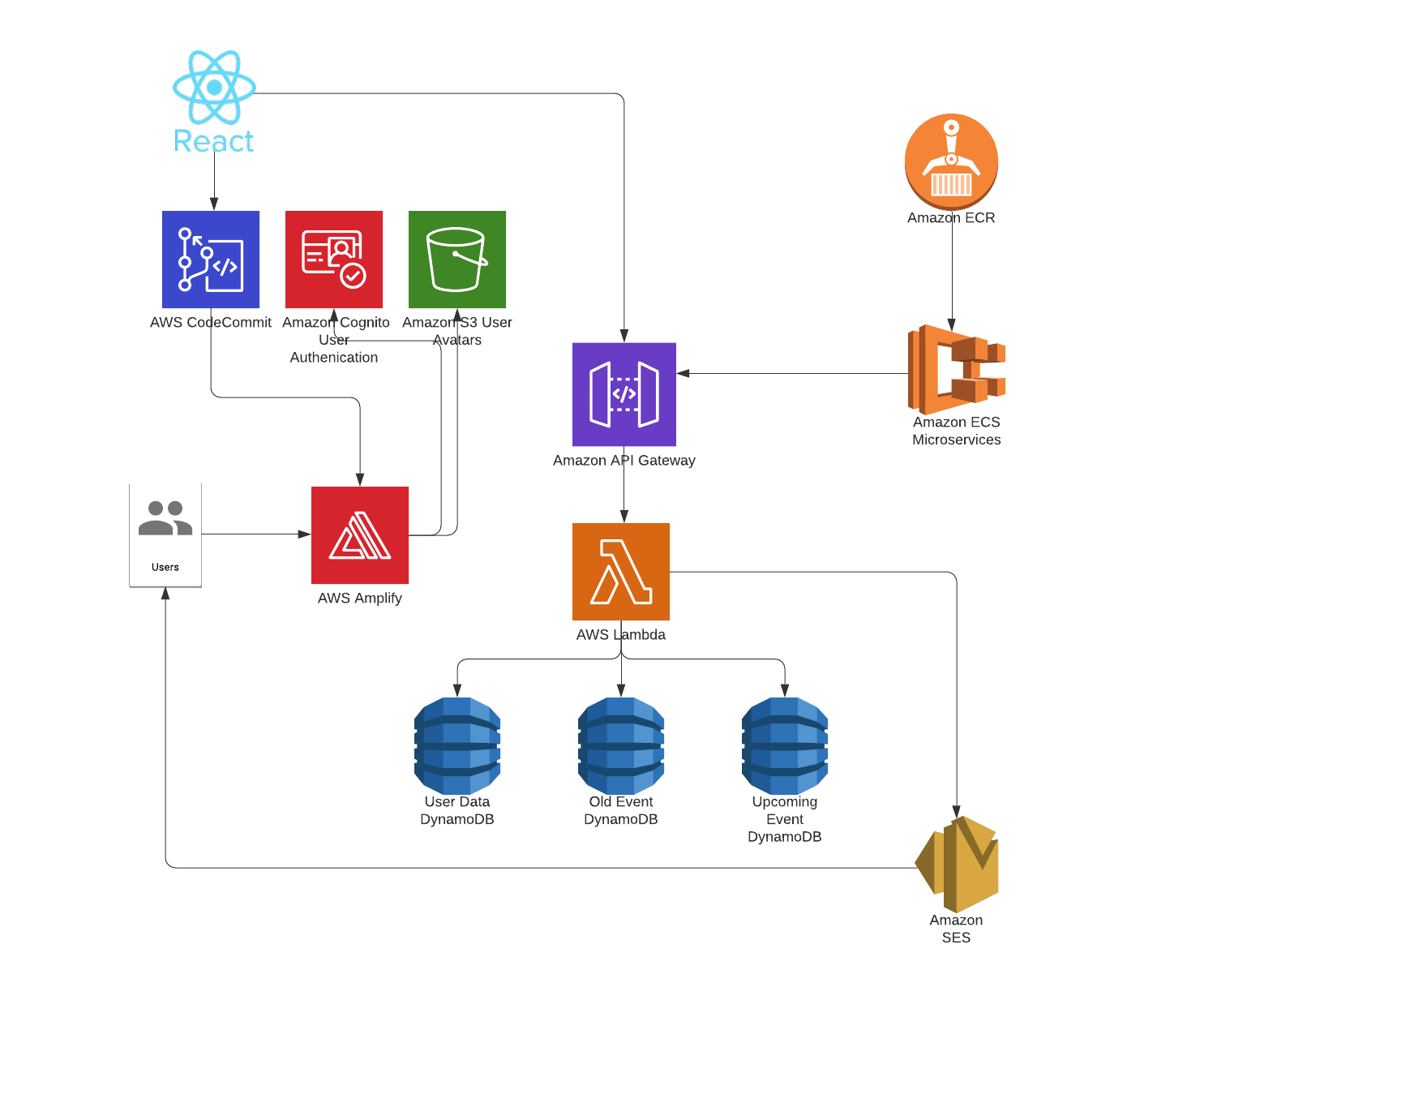
Front end written in React
Hosted by AWS Amplify
Cognito and S3 integration
API Gateway triggers a Lambda function which completes operations on the database
ECS cluster running microservices
Overview of Application Architecture
Notes:
Our web application is hosted by AWS Amplify. Amplify allows us to easily integrate with AWS Cognito (for user authentication) and AWS S3 (for avatar storage). To connect our web application to the database we set up an AWS API Gateway to receive requests and trigger a Lambda function which parses the request and completes the specified operation on the database.

Slide 10
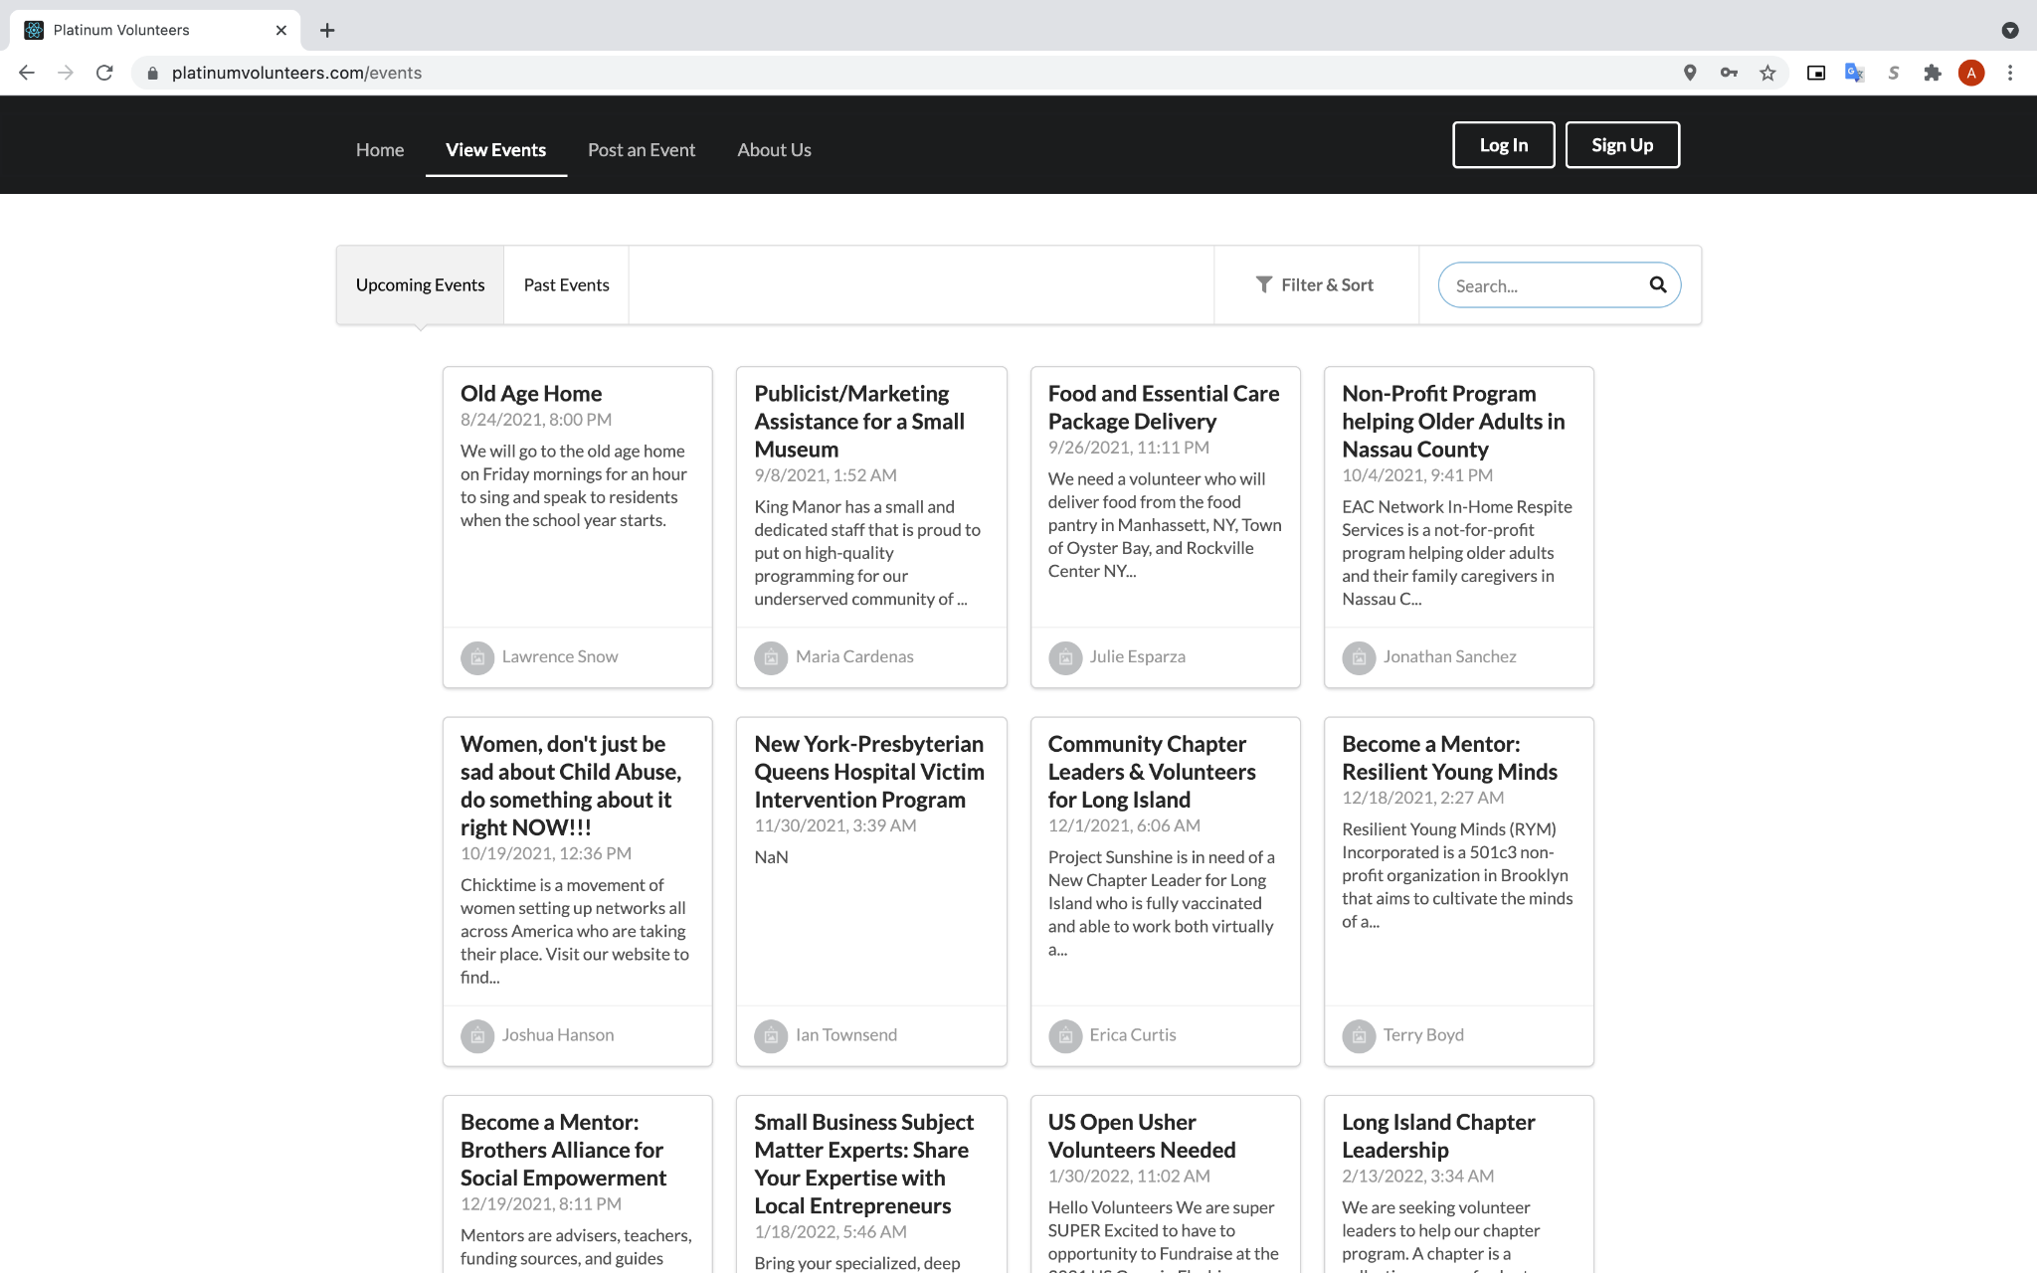
Application front end
Our web app is written in Javascript using the React library (https://reactjs.org)
We used Semantic UI (https://semantic-ui.com) components to build the user interface
A React router (https://reactrouter.com) was used to display different pages
React states were used to display dynamic content

Slide 11
Application Flow – User signup & log in
New users are asked to create an account with their email address and a password.
They must also provide some additional information such as their name and date of birth.
We collect the information a user enters in a react state
We call Amplify authentication’s Auth.signUp() function and pass in the user data
Amplify will email the user a confirmation code that they must enter to ensure user authentication.
Amplify then adds the new user into the Amazon Cognito user pool
We also create a new entry in a DynamoDB table of users in order to store additional user data
Now that users have an account, they can log in with their email address and password.
We use Amplify authentication to handle login

Slide 12
Application Flow – Create event
Users have the ability to give their event a title, description, additional information, location, date, and tags
Tags are used to categorize events for more efficient searching and suggesting of events
When a user goes to post an event, they must enter the event information which we temporarily store in a react state
Once the user submits the event, we create an entry in the database for the event by calling the API gateway which passes the information to the Lambda function, which stores it in DynamoDB
When the event is first added to the database, it is flagged as “not approved.” From the admin panel, site administrators can approve or reject events.

Slide 13
Application Flow – Searching events
When a user opens the events page, a call is made to the API gateway which calls the Lambda function that retrieves and returns the approved events from the DynamoDB table
The events are saved in a react state and displayed to the user
The user has the option to sort the events by date, distance, or alphabetically
Users can search events by keyword in addition to being able to filter events by their tags or distance
Users also have the ability to view past events
When a user clicks on an event, they can view information about the event including the description, address (with a google map), weather, event organizer, as well as the names of other volunteers.

Slide 14
Application Flow – Registering for events
When a user registers for an event, a call is made to the API Gateway which handles the joining of event
The user’s ID is added to the event’s list of participants in the event database
The event’s ID is added to the user’s list of upcoming events in the user database
An additional API call is made to send an email to the user thanking them for joining the event and giving them the event information
Users can also unregister which calls the API Gateway to remove the user from the event participants and remove the event from the users upcoming events
Users are assigned a unique ID for the event to generate a QR code that the event organizer is able to scan on the day of the event to check in volunteers

Slide 15
Database Management

Slide 16
Data Flow
Data is written, read, updated, and deleted through a Lambda function that manages the database.
This Lambda function is accessed by the front and backend code through an API Gateway
Request
App
API Gateway
Lambda Function
Dynamo DB
Response

Slide 17
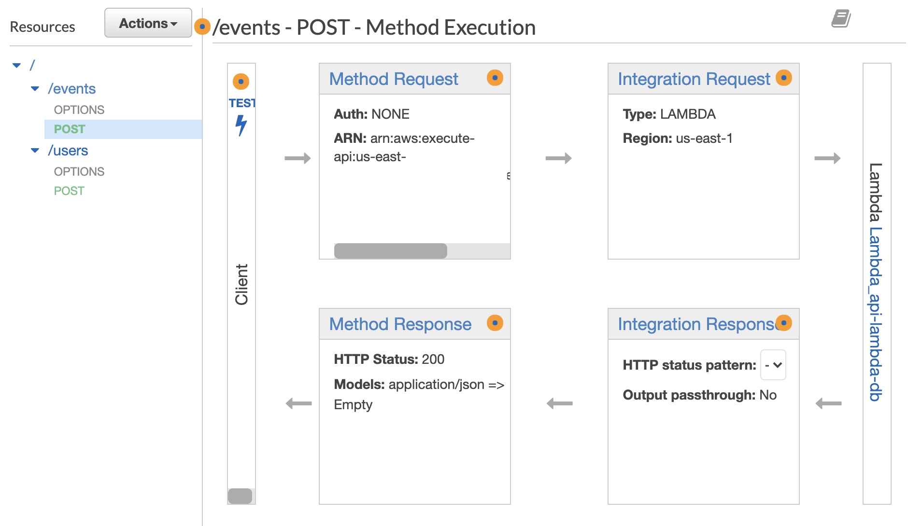
AWS API Gateway
REST API with /events and /users
Request body passed to AWS Lambda via POST
CORS Enabled
Notes:
REST API- the API has /events and /users routes
Supported POST requests- The body of the request is passed to the lambda function
CORS enabled- Since the API is able to return database information to the requester, CORS must be enabled

Slide 18
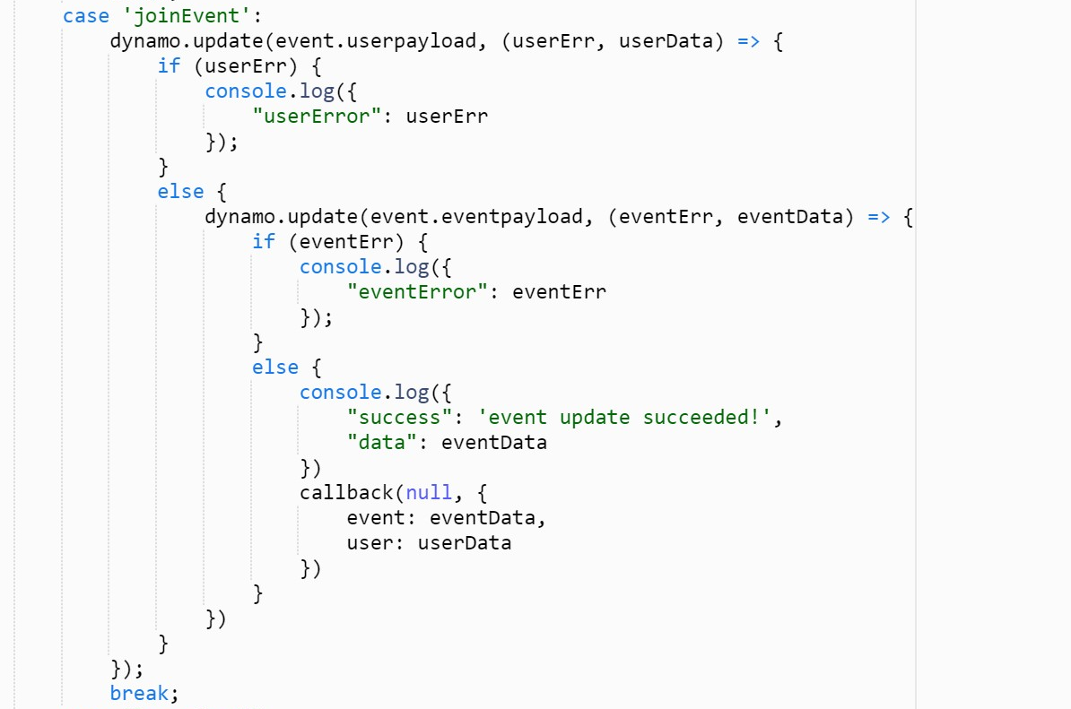
AWS Lambda Function
Written in Node v12
Triggered by the API Gateway
Parses the body of the POST request and completes the desired operations
Originally it only supported CRUD operations. However, as the application evolved, more complex operations were added. For example: ➞

Slide 19
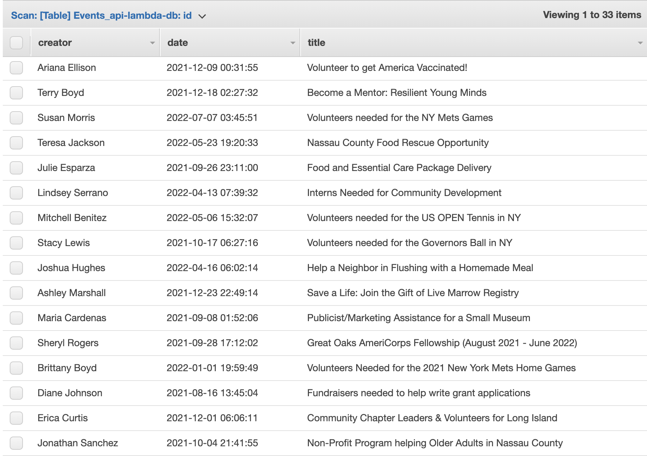
Dynamo DB
Three tables were used to manage app data- Users, Events, and Old Events
The access to these tables is restricted to the Lambda function which is responsible for the data management

Slide 20
"Item": {
"id": {"S": "0"},
"name": {"S": "Jimmy Smith"},
"email": {"S": "downsjoshua@hotmail.com"},
"phone": {"S": "7217881508"},
"upcomingEvents": {
"L": [{"S": "12400"},
{"S": "3695"},
{"S": "15500"}]},
"pastEvents": {
"L": [{"S": "5790"},
{"S": "5885"},
{"S": "6810"},
{"S": "7565"},
{"S": "9730"}]
},
"bio": {"S": "Put able I police long class. Southern reflect attack music likely visit she time. Single per think unit military. But someone civil explain black seat. Son sit down offer."}
}
}
User Data
ID- a unique string generated by AWS Cognito
Name
Email- To send reminders about their upcoming events
Past Events- Past events that the user volunteered for
Upcoming events- Future events that the user volunteered for
Bio- The user can update the bio on their profile
Phone- The user could set their phone number on their profile page

Slide 21
Event Data
"Item":{
"title": {"S": "Become a Mentor: Resilient Young Minds"},
"id": {"N": "17555"},
"creator": {"S": "Terry Boyd"},
"creatorEmail": {"S": "broberts@yahoo.com"},
"location": {"S": "595 Brown Dr.\r\nSouth Ozone Park, NY 11420"},
"date": {"S": "2021-12-18 02:27:32"},
"description": {"S": "Resilient Young Minds (RYM) Incorporated is a 501c3 non-profit organization in Brooklyn that aims to cultivate the minds of at risk youth into resilient ones. Throughout the mentoring year, which starts in September and ends in June, RYM works towards a goal of enhancing the ability of adolescents to achieve self-efficacy despite difficult or traumatic experiences. It is in RYM's mission to invest"},
"approved": {"BOOL": true},
"public": {"BOOL": true},
"tags": {"L": []},
"participants": {"L": [
{"S": "222fdf74-2767-4b88-8623-3ad8a1d4b921"},
{"S": "4"}
]
}
}

Slide 22
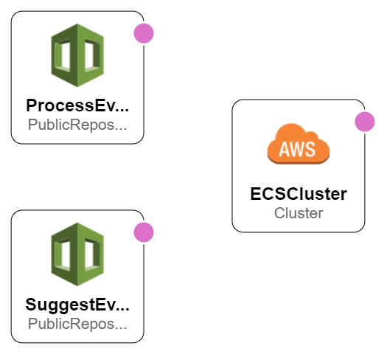
Microservices

Slide 23
Microservices
Code for microservices was containerized with Docker, uploaded to AWS Elastic Container Registry (ECR), and run on an AWS Elastic Container Service (ECS) cluster every 6 hours
ECR stores the docker images
Docker images used in an ECS task definition
Task run on ECS cluster
Every 6 hours

Slide 24
Information:
Code was built in Node js v12
Containerized using Docker
Pushed to AWS Elastic Container Registry
Microservice #1- Process Upcoming Events
Function:
Iterate through all events in the upcoming events table
Remove events that have past and place them in the old events table
Send a reminder email to the participants of immanent events
Microservice #2- Suggest Events
Function:
For each user, count up the number of times each event tag is found in their past events
Based on this data, rank upcoming events on how well they match this users preferences
Suggest the top four matches to the user

Slide 25
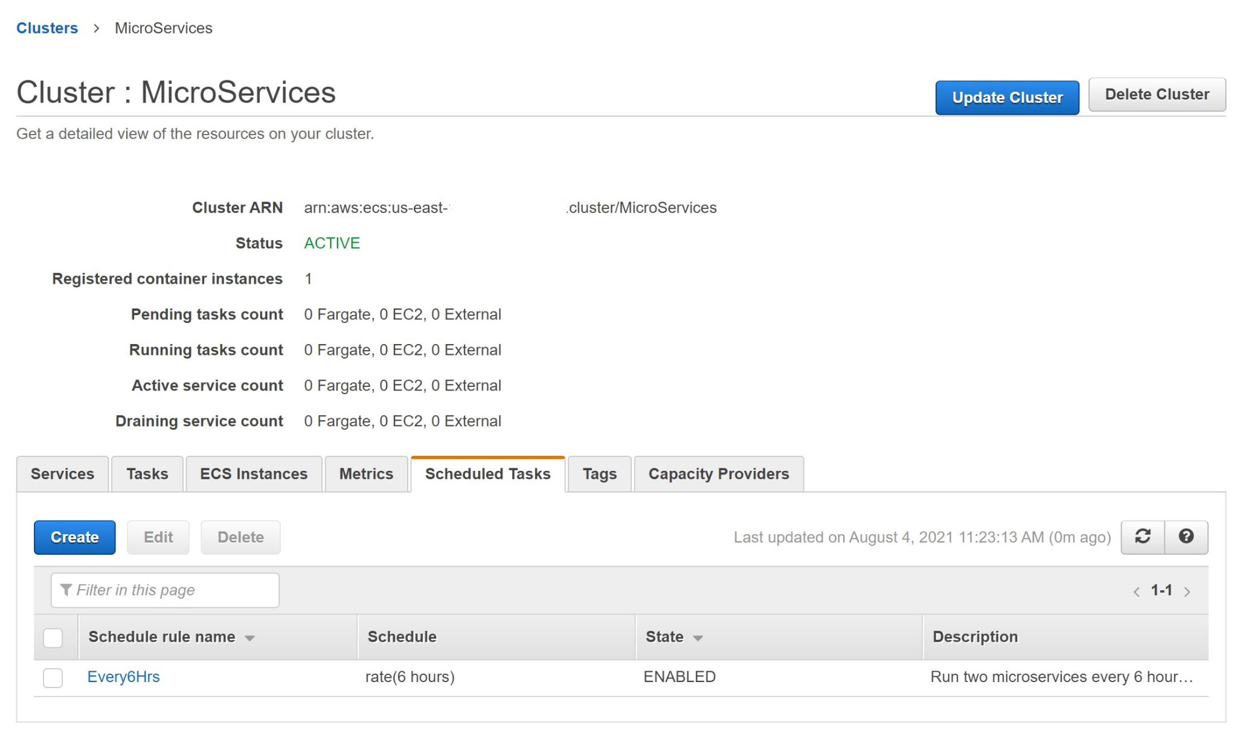

Slide 26
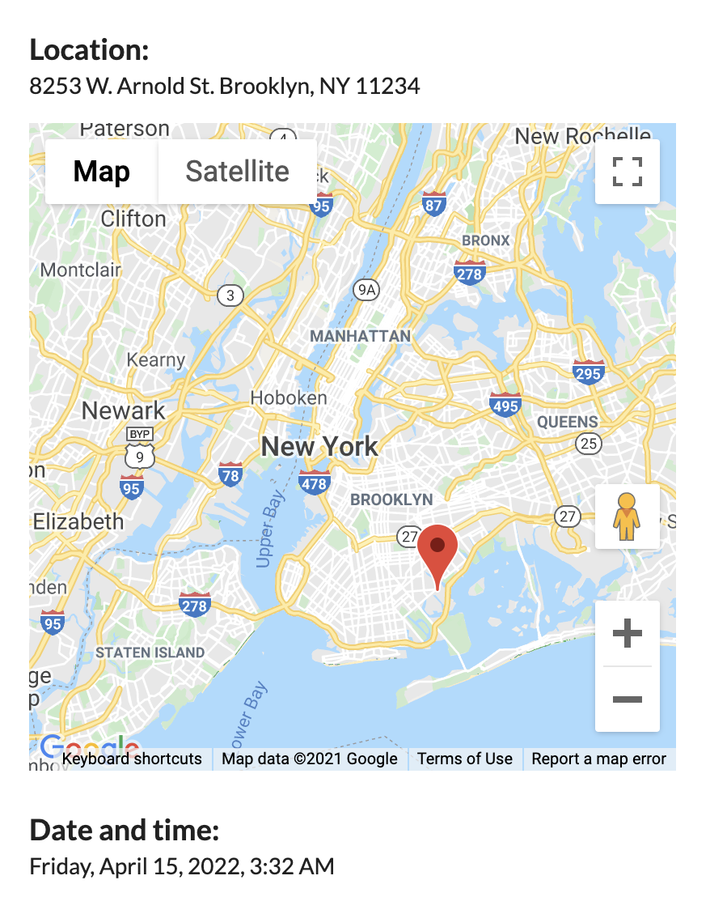
Google maps Integration
We retrieve the latitude and longitude from the place the user entered using an API call to Google Geocode.
The latitude and longitude was then used to pull up a google map representing the location on the view events page using an api call to Google Maps.

Slide 27
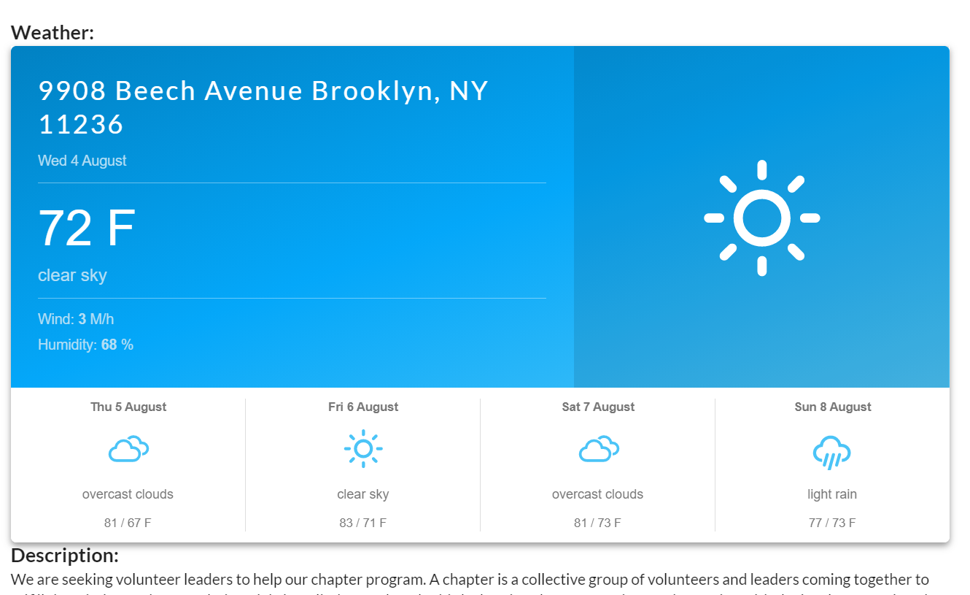
Weather Integration
We called the react open weather api to show the weather so the user will know what the weather will be like at the time of the event.
The weather forecast shows up on the view event page with all the other information about the event.

Slide 28
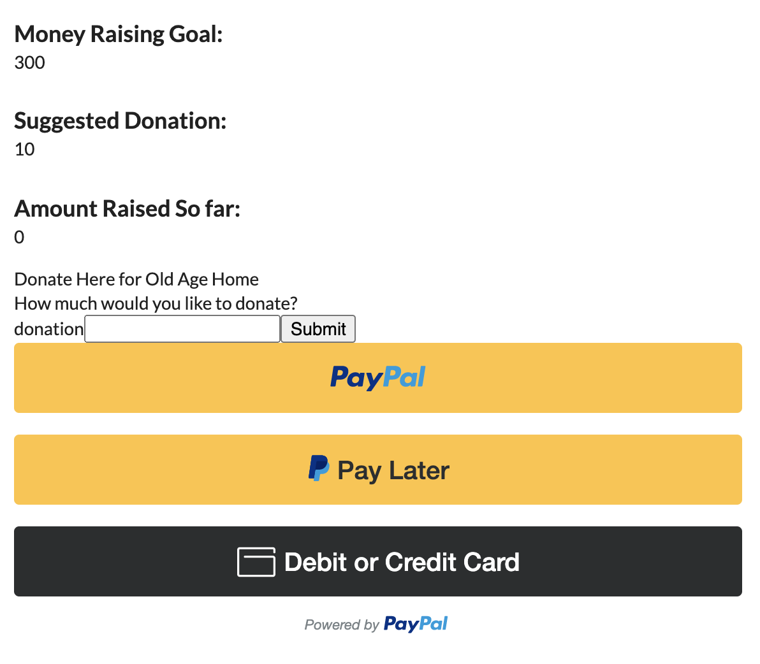
PayPal Integration
We called the paypal api to give the user an option to donate to help raise money for events.
When the user donates the amount of money raised so far in the database gets updated

Slide 29
How to Set Up the App
You will need:
An active AWS account
The AWS command line interface
NodeJS with NPM
AWS Amplify CLI (You can install this using NPM)
Docker

Slide 30
How to Set Up the App
Start by cloning the repository
git clone https://github.com/azrielb1/Platinum-Volunteers.git
Run cloudformation templates
aws cloudformation create-stack --stack-name API-Lambda-DB --template-body file://./cloudformation/API-Lambda-DB/template.json --parameters ParameterKey=LambdaFuncName,ParameterValue=CRMLambda ParameterKey=UsersTableName,ParameterValue=CRMUsersTable ParameterKey=APIName,ParameterValue=CRMAPI ParameterKey=EnvironmentName,ParameterValue=Prod --capabilities CAPABILITY_IAM
aws cloudformation create-stack --stack-name MicroServices --template-body file://./cloudformation/MicroServices/template.json
Complete API setup
enable cors
Add APIGateway as a trigger for the Lambda
Open AWS Console and go to Lambda
Choose CRMLambda
Choose "Add Trigger"
Select API Gateway and choose the CRMAPI
Add your endpoint URL to Platinum-Volunteers/src/APIFunctions.js as well as in Platinum-Volunteers/EC2_scripts/EventSuggesterMicroServ/APIHelperFunctions.js and Platinum-Volunteers/EC2_scripts/ProcessEventsMicroServ/APIHelperFunctions.js

Slide 31
How to Set Up the App
Complete MicroServices setup
Create Docker image for both sub-directories
cd ProcessEventsMicroServ
docker build -t process_old_events .
cd ../EventSuggesterMicroServ
docker build -t Event_Suggester .
cd ..
Push images to ECR
Schedule task with ECS
Go to AWS ECS console
Create new task definition
Use the images you pushed to ECR
Schedule task to run every 6 hours on the cluster created by cloud formation

Slide 32
How to Set Up the App
Set up Amplify backend with AWS Cognito for user authentication, and S3 for avatar storage.
Initialize the amplify project. amplify init
Configure an Amazon Cognito User Pool to manage user credentials. amplify add auth
# When asked how you why do users to sign in choose "Email"
Configure an Amazon S3 bucket to store avatars. amplify add storage
Deploy your backend. amplify push
# When asked if you would like to generate client code, you can
# say no since we are using plain JavaScript.
You may set up the front end from the amplify console

Slide 33
How to Set Up the App
Set up the .ENV file with API keys to enable various 3rd party integrations.
obtain a open weather API key and Google Maps API key
enter them in the .env file
Install dependencies npm i
Run the app npm start

Slide 34
Main takeaways/lessons learned
Agile development
Using Git to collaborate effectively and efficiently with a team
Familiarity with powerful AWS services such as Amplify, API Gateway, Lambda, DynamoDB, ECS, Cognito, SES, S3, and CodeCommit
Experience with web development using React.js
Experience designing and invoking REST APIs

Slide 35

Thank you!
Github: https://github.com/azrielb1/Platinum-Volunteers

